Slide 1
An introduction to some digital tools for Bayesian Data Analysis (BDA)
Alan Pickering
Dept. of Psychology
Goldsmiths, University of London
a.pickering@gold.ac.uk

Slide 2
Preliminaries
All the materials for this set of workshops/tutorials are in an open access repository
https://github.com/Alan-Pickering/Bayesian-data-analysis-teaching
These slides are there
Bayesian Data Analysis Part 1.pptx
as are later powerpoint tutorials, explainer documents and my code in Matlab

Slide 3
Overview
What is Bayes Theorem?
Key terms and concepts
Bayesian Statistical Analysis
How to do this using JASP
Bayes factor for Bayesian Model Comparison
In JASP and using other tools

Slide 4
What is Bayes Theorem?
Excellent paper on its foundations and basic concepts
Etz, A., & Vandekerckhove, J. (2018). Introduction to Bayesian Inference for Psychology. Psychonomic Bulletin & Review, 25(1), 5–34.

Slide 5
What is Bayes Theorem?
An Essay towards solving a Problem in the Doctrine of Chances.
Published in the Phil. Transactions of the Royal Society of London in 1763, after Bayes’ death, by his friend Richard Price, a Unitarian minister who was literary executor of his estate. Price wrote many comments and additions to the text.

Slide 6

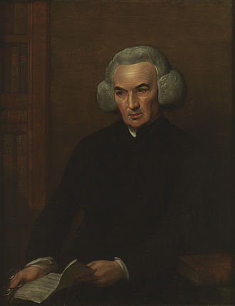
Bayes and Price

Slide 7
What is Bayes Theorem?
Main statement of the theory was a minor component of the essay, which addressed a broader problem
"If there be two subsequent events, the probability of the second b/N and the probability of both together P/N, and it being first discovered that the second event has also happened, from hence I guess that the first event has also happened, the probability I am right is P/b.“

Slide 8
In modern notation
Which implies :-

Slide 9
Key Bayesian terms
y is the data; θ are the model parameters

Slide 10
Bayes Theorem
It is often described as a theorem about inverse probability
We know about forward probabilities: if it is a fair deck of cards (FD) what is the probability that a card, drawn at random, will be a spade (S)?
Answer= 1/4
P(S|FD)=1/4

Slide 11
Inverse probability
If we draw a spade at random (S) what is the probability that it is a fair deck (FD)?
What is p(FD|S)?
We can use Bayesian inference, based on Bayes’ theorem, to work it out

Slide 12
Uses of Bayes’ Theorem: Part 1
1. Using Bayesian statistical analyses
2. Using Bayesian methods to compare the fit of models to data (Bayesian Model Comparison)

Slide 13
Bayesian Stats
Need to understand why traditional stats have been criticised
Traditional stats = null hypothesis significance testing (NHST)
Need to understand something called Bayes Factors
Bayesian equivalents of most familiar traditional tests are available
Now very easy to compute using software such as JASP

Slide 14
What’s wrong with NHST?
Many users remain confused about what NHST really does, and what the p-value represents
H0 = null hypothesis
H1 = alternative hypothesis

Slide 15
A little quiz …
A p value of 0.02 means which of the following are true:
H₀ has a 2% chance of being true
H₁ has a 98% chance of being false
There is a 2% chance that replicating the experiment would lead to the same result
There is a 2% chance of falsely rejecting H₀
This finding is less important than another finding with a p-value of 0.001
Some (but not all) of the above

Slide 16
The p value
None of the above are true
Under ideal circumstances, a p value of 0.02 means that……
If H₀ is true then you would have had a 2% chance of finding a value of your test statistic as large (or small) as the one that you computed.

Slide 17
What’s wrong with NHST?
It doesn’t tell you (much) about things you really want to know, such as:
the probability of H₀ being true
the probability of H₁ being false
The probability of replicating the result that you obtained

Slide 18
The dance of the p-values
Watch
https://www.youtube.com/watch?v=5OL1RqHrZQ8
The p-value you obtain in a study is not at all predictive of the p-value you will get in a replication

Slide 19
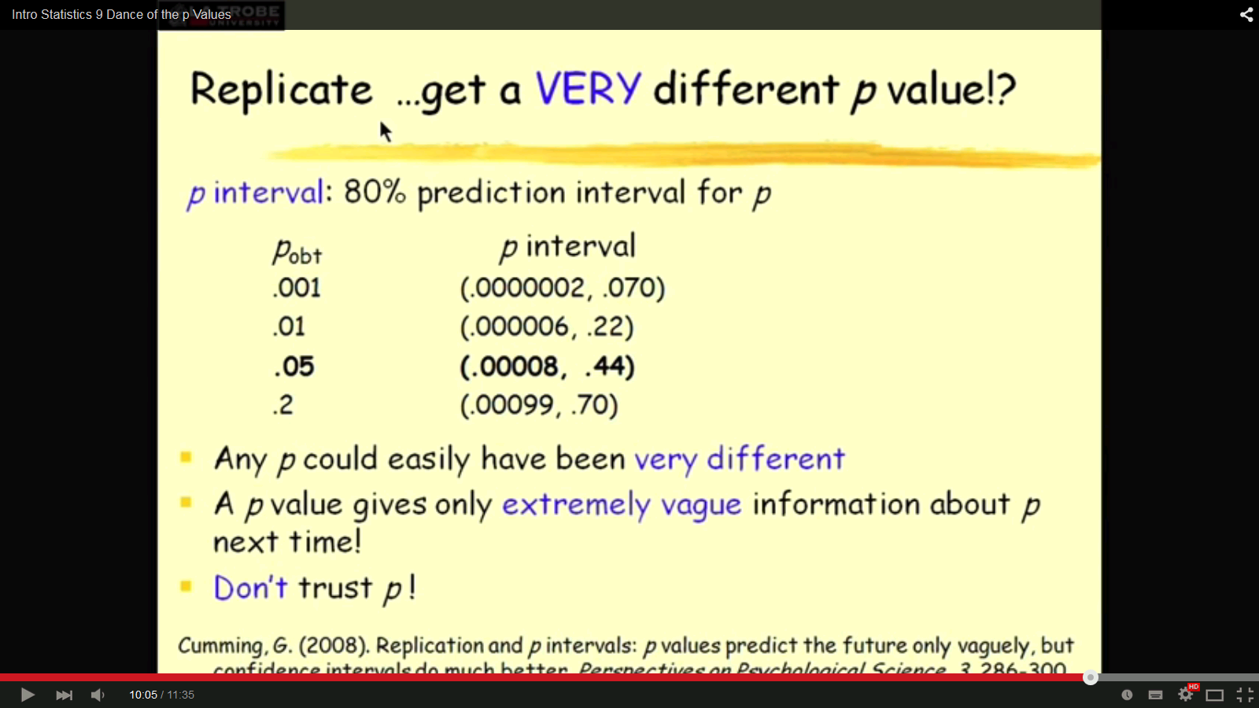

Slide 20
What can you do instead of NHST?
One can adopt so-called Bayesian statistical methods eg by
Computing “Bayes factors”
But note there is a dance of the Bayes factors, too
http://daniellakens.blogspot.com/2016/07/dance-of-bayes-factors.html

Slide 21
Bayes factors, BF
A simple number from 0 to infinity expressing the weight of evidence (change of odds for H_{A} relative to H₀) from prior to the experiment to after the data (D) have been gathered
BF=1 is no change in weight of evidence
Often expressed on a log scale

Slide 22
Bayes factors
Odds of H_{A} after study
Bayes Factor
Odds of H_{A} prior to study

Slide 23
Interpreting Bayes factors

Slide 24
Bayes factors vs. traditional stats

Slide 26
Bayesian Stats
So we are going to do some Bayesian stats in the free software called JASP
JASP is very easy to use without an instruction manual, but there is a free online book
https://learnstatswithjasp.com/
And there is an online guide to Conducting and Reporting Bayesian Analyses using JASP
https://psyarxiv.com/yqxfr/
And a very informative blog
https://www.bayesianspectacles.org/

Slide 27
Bayesian Stats
We are going to use JASP to carry out the analyses of the “Case Studies” reported in this paper

Slide 28
Bayesian Stats: Case Study 1
Gibson et al’s (2014) attempted replication of Shih et al (1999)

Slide 29
Bayesian Stats: Case Study 1
All the case studies used by Dienes and Mclatchie (2018) are from an Open Access special issue of Social Psychology (2014, vol 45, issue 3), trying to replicate published studies
https://us.hogrefe.com/products/journals/social-psychology

Slide 30
Bayesian Stats: Case Study 1
All the case studies used by Dienes and Mclatchie (2018) are from an Open Access special issue of Social Psychology (2014, vol 45, issue 3), trying to replicate published studies
https://us.hogrefe.com/products/journals/social-psychology
You can find the Open Science Framework URL for the data at the end of each paper

Slide 31
Bayesian Stats: Case Study 1
Gibson et al (2014)
use the link
http://osf.io/5itqa

Slide 32
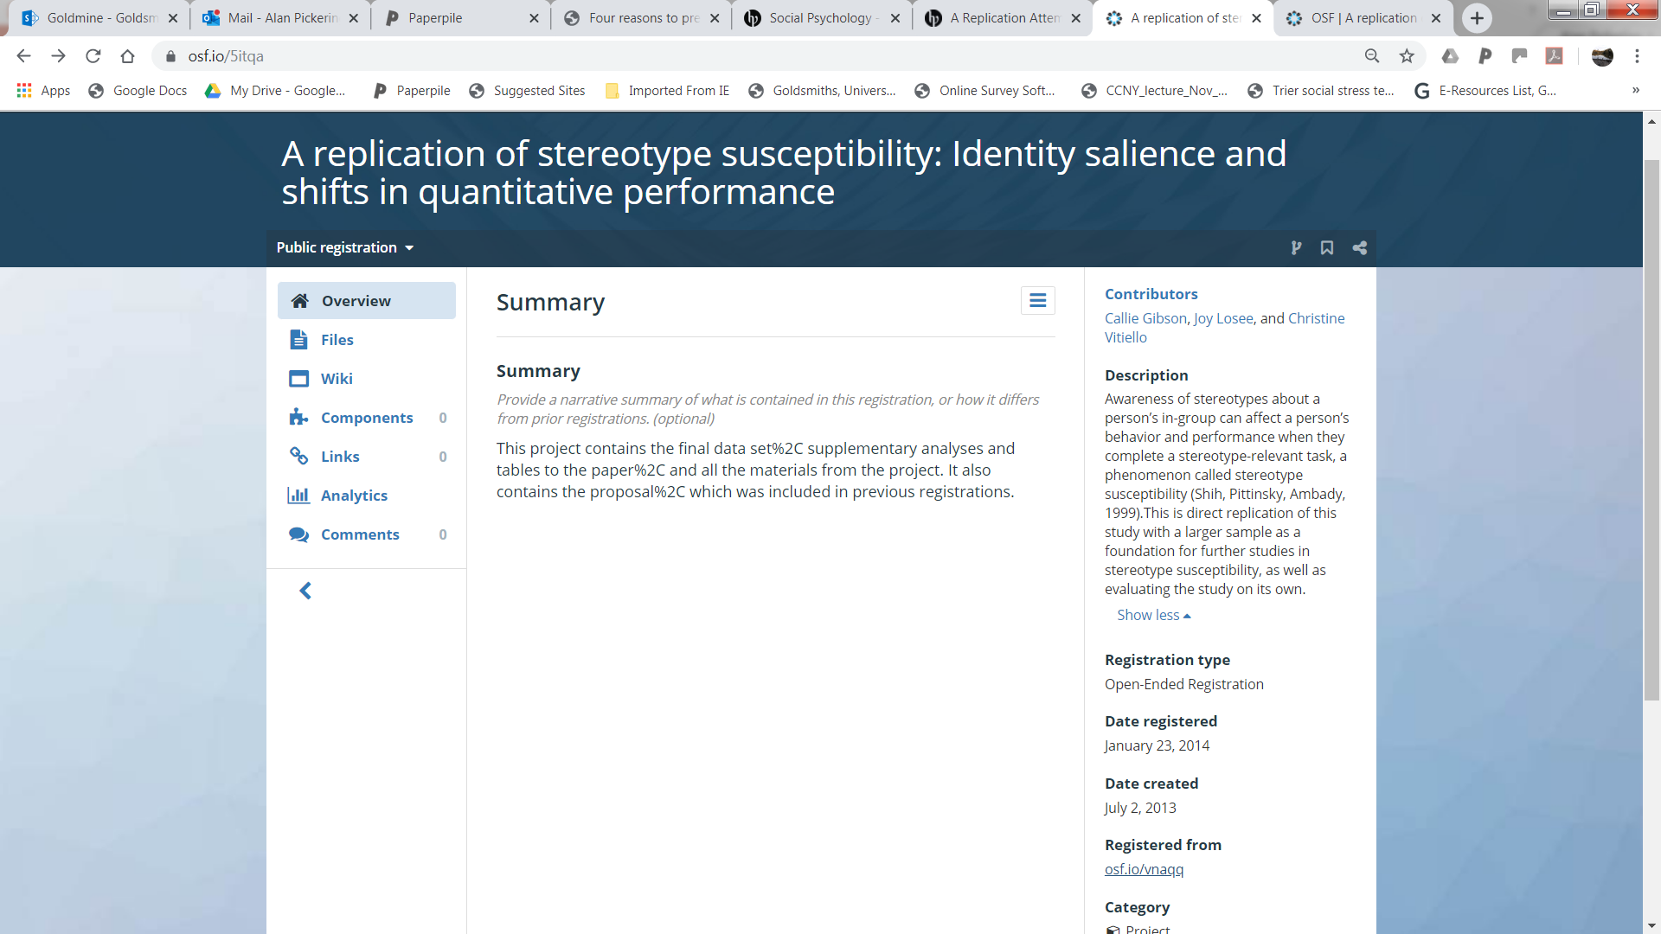
OSF repository for Gibson et al (2014)

Slide 33
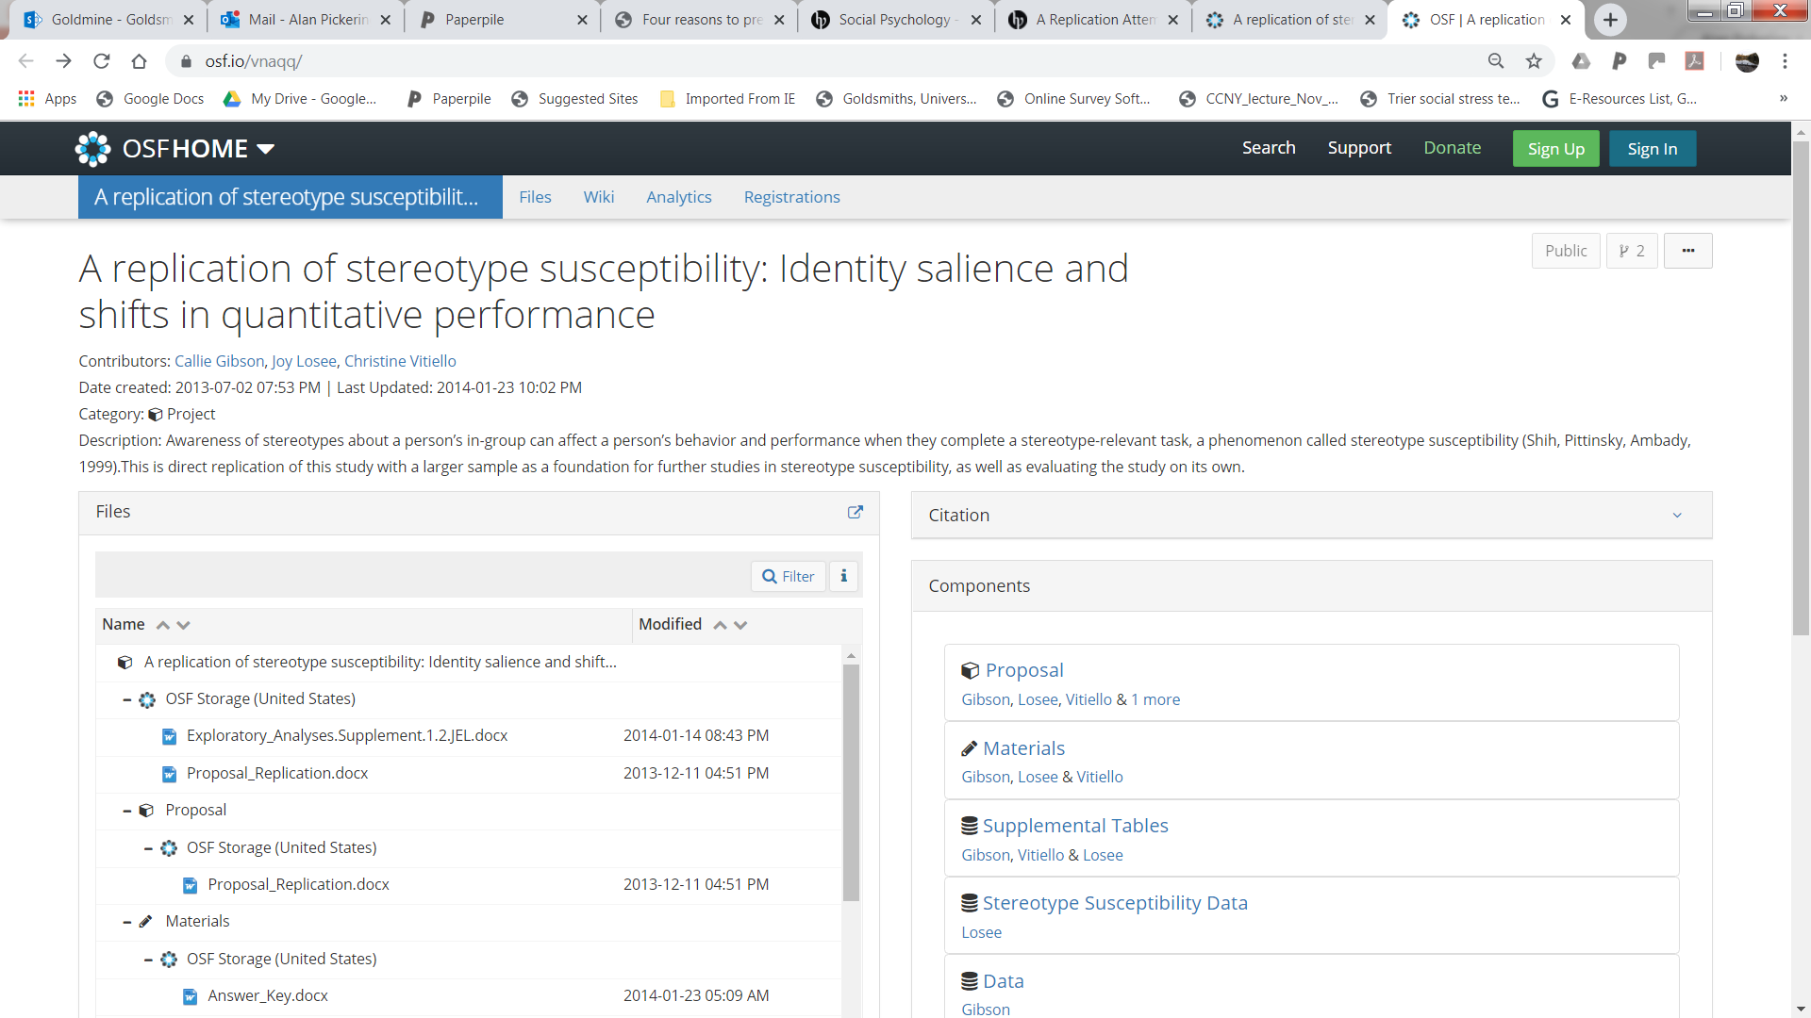
OSF repository for Gibson et al (2014)

Slide 34
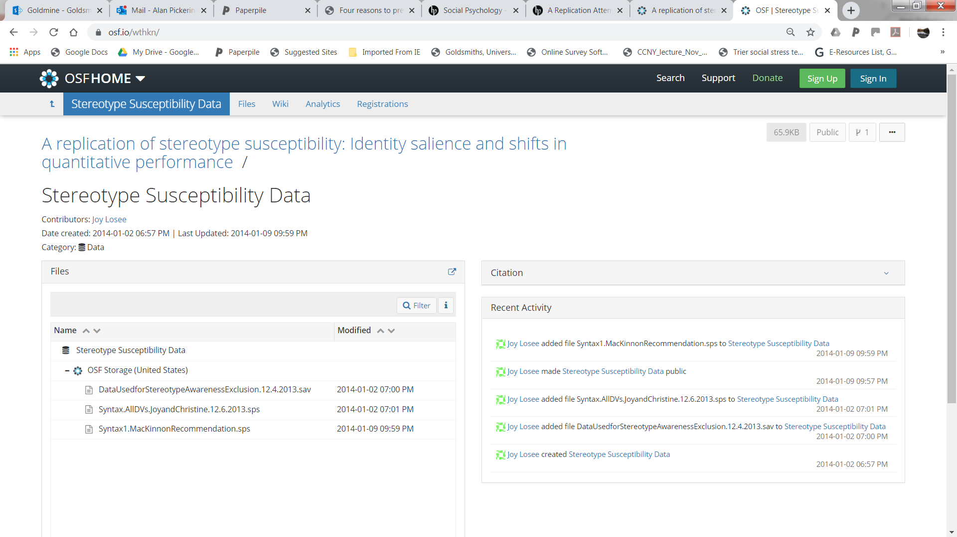
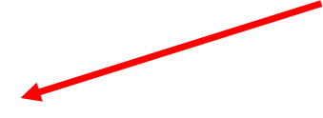
Data for Gibson et al (2014)

Slide 35
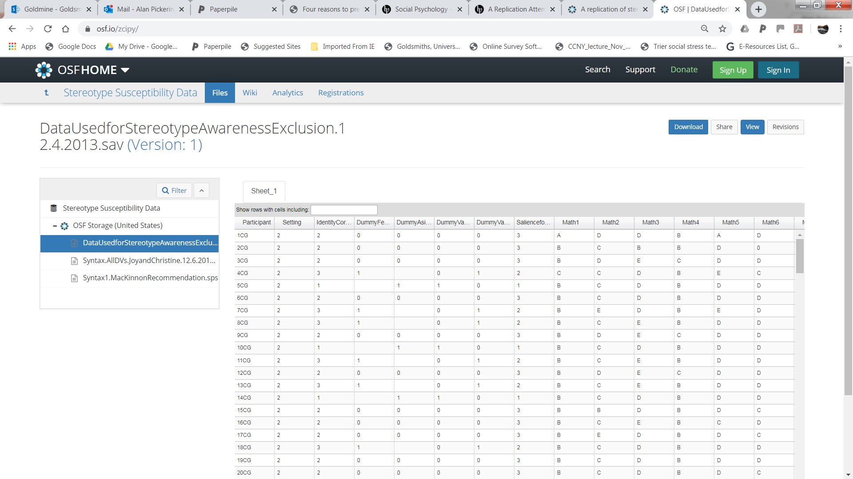

Data for Gibson et al (2014)

Slide 36

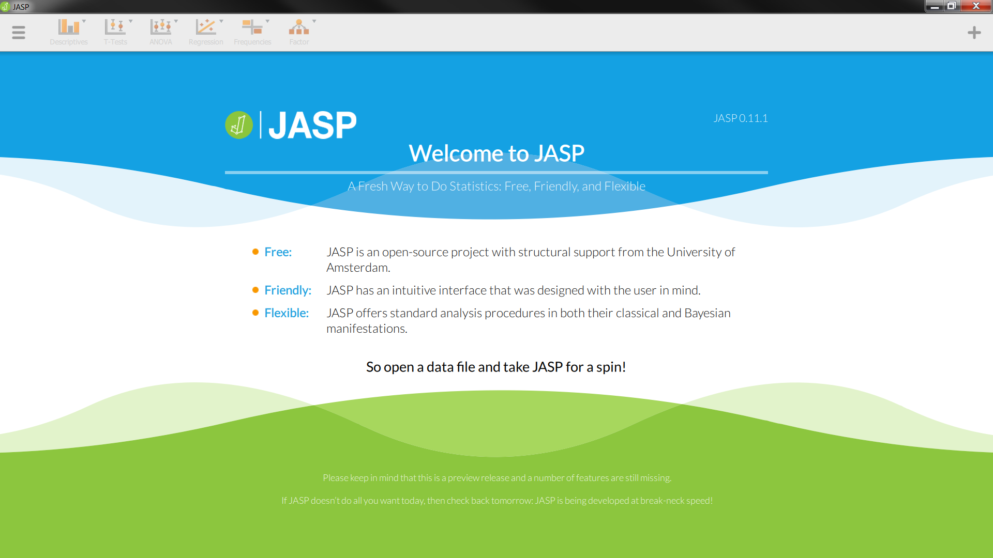
Open JASP

Slide 37
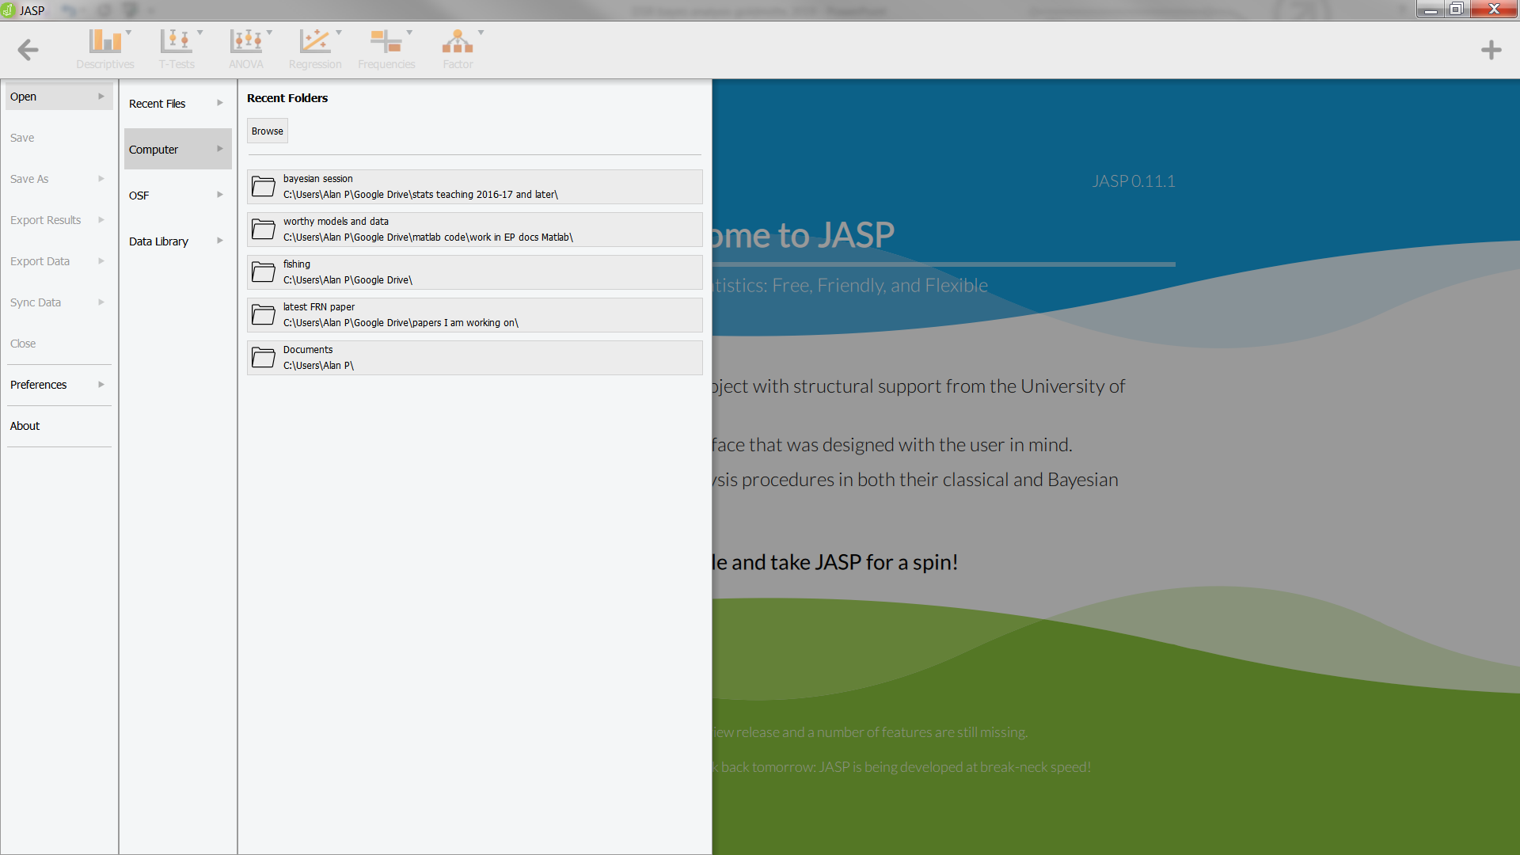
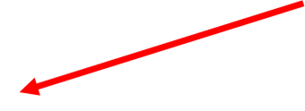
Load in some data

Slide 38
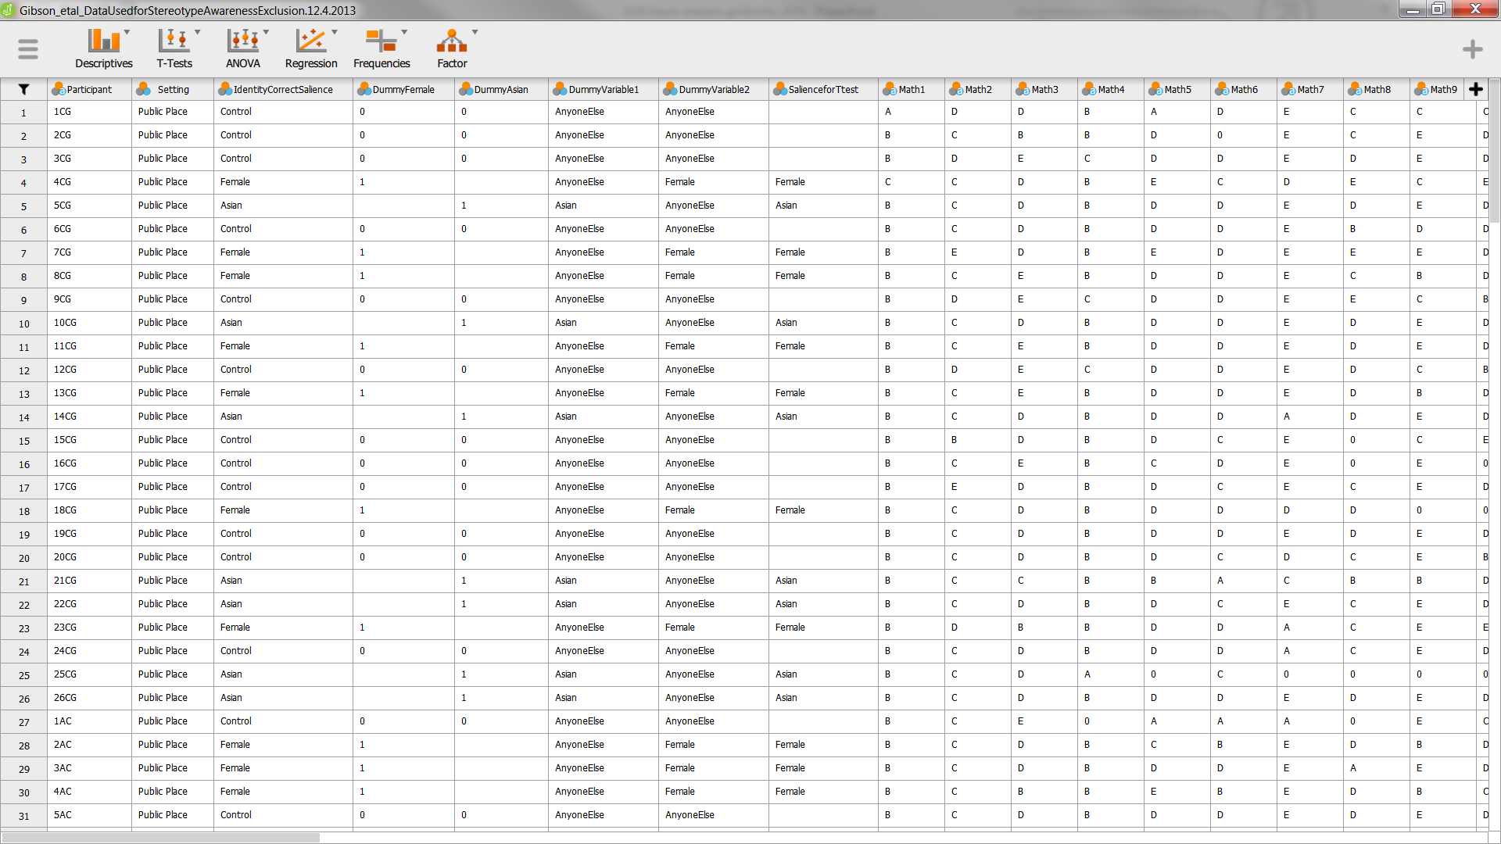
Open Data in .SAV format

Slide 39
Replicate the NHST result
You need to check the variables used and any filtering / exclusions which were applied
This info is given in the SPSS syntax (.sps) file in the OSF for Gibson et al
For the analysis focussed on by Dienes:
filter using variable = filter_$
The DV = accuracy
The grouping variable is IdentityCorrectSalience
The analysis is an independent groups t-test for “female” vs. “Asian” groups

Slide 40
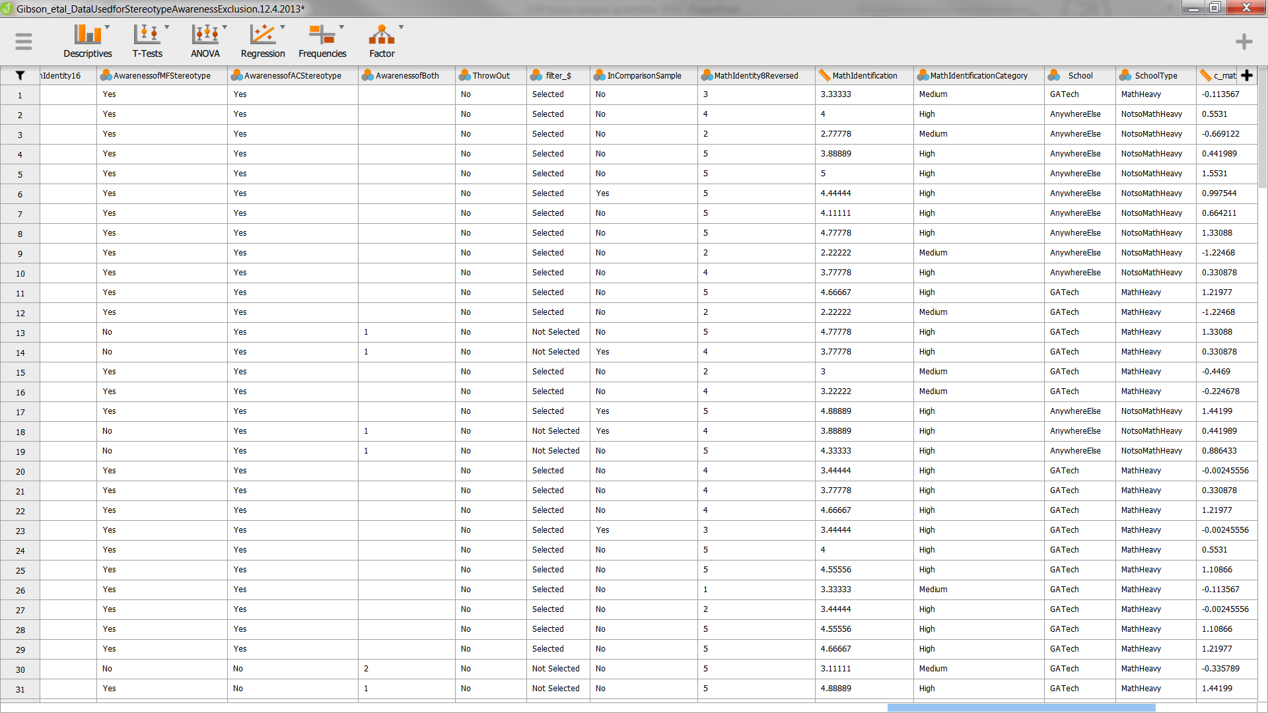

First do filtering: Click on variable label

Slide 41
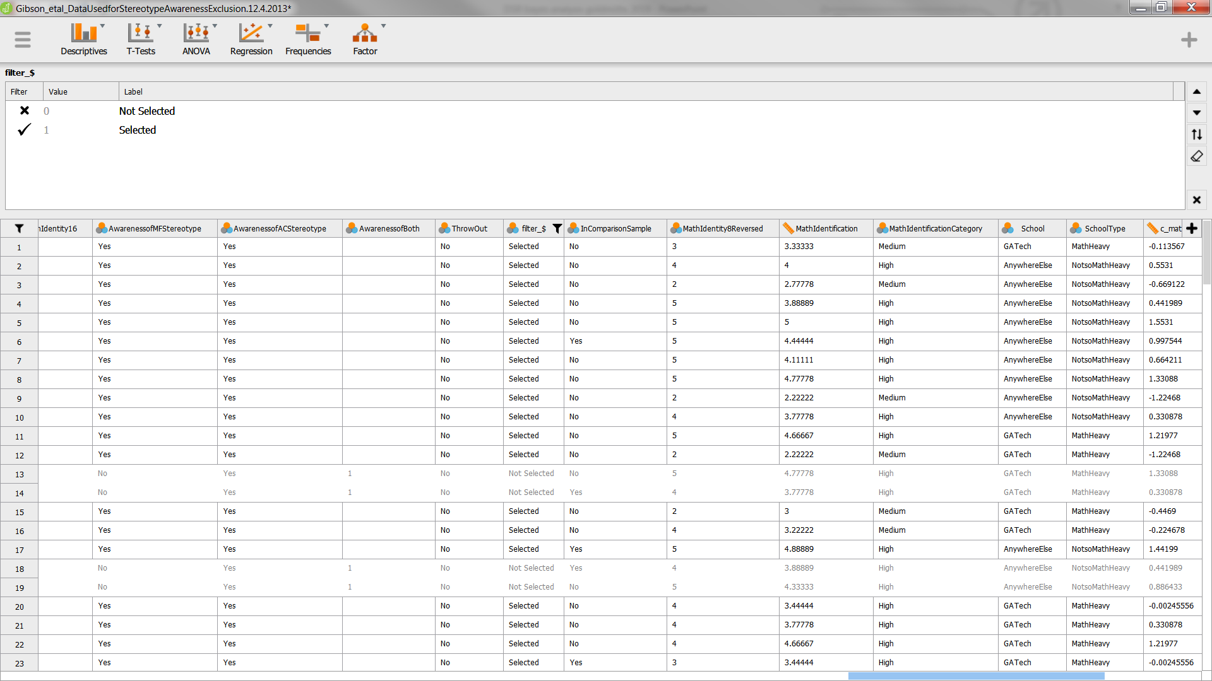

First do filtering: Toggle values to include

Slide 42
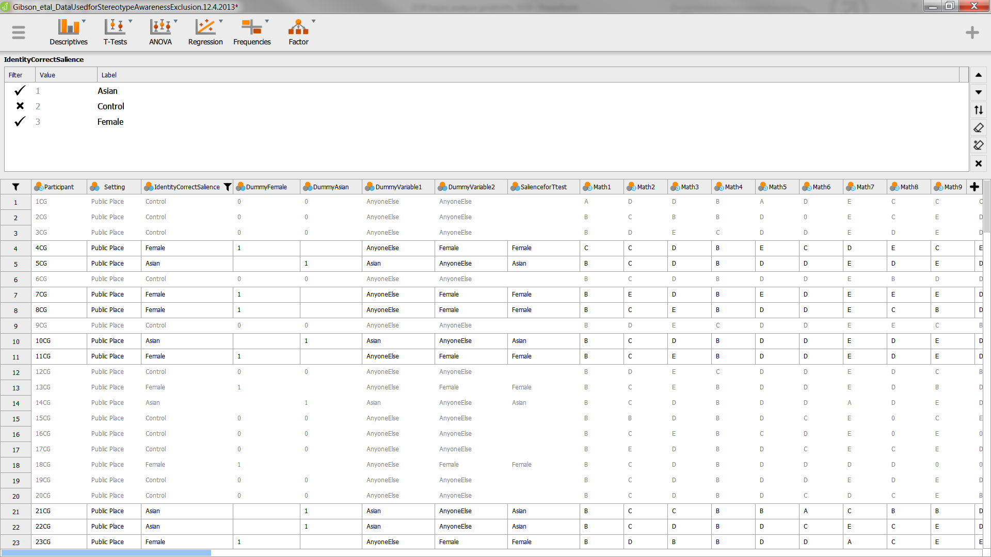

Indep gps t-test: Select 2 groups to compare

Slide 43
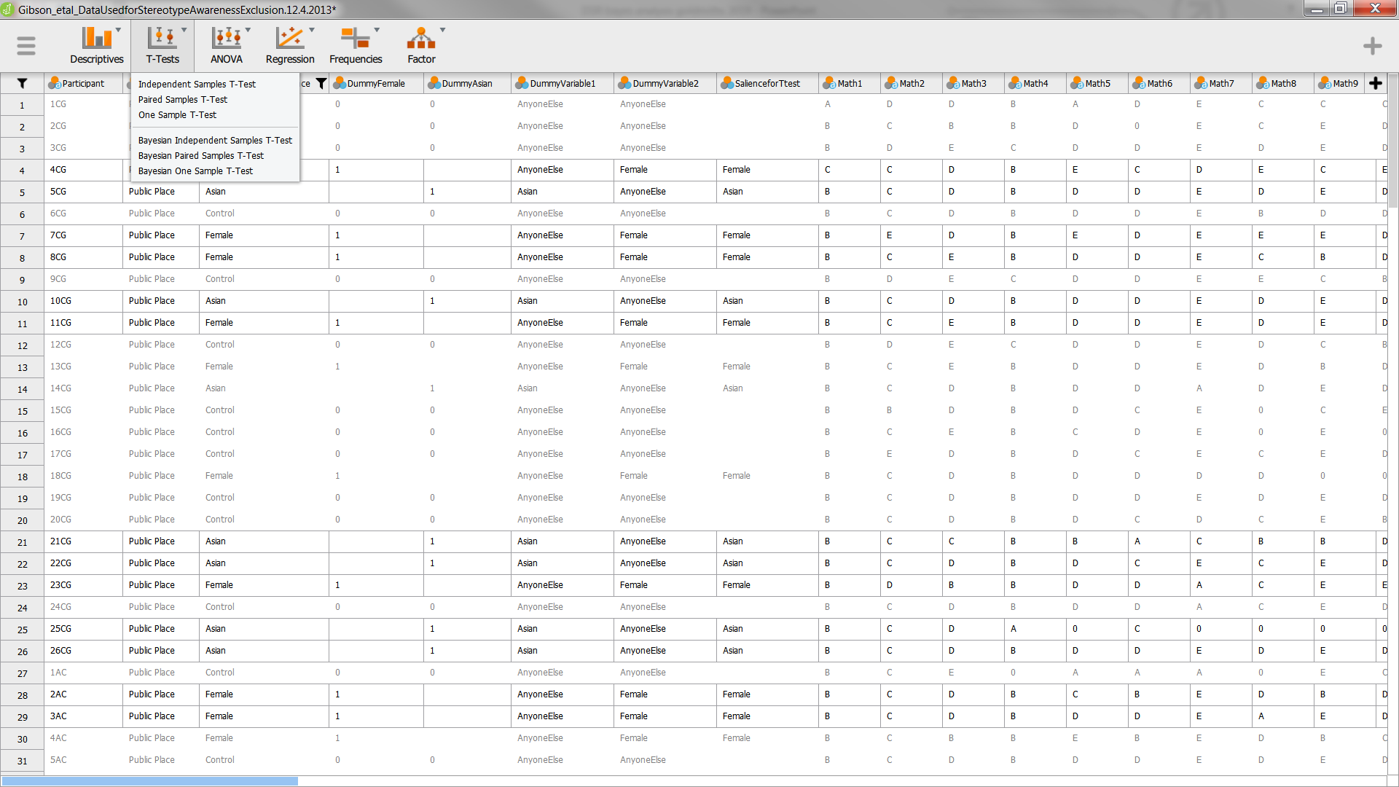
Indep gps t-test: Run the analysis

Slide 44
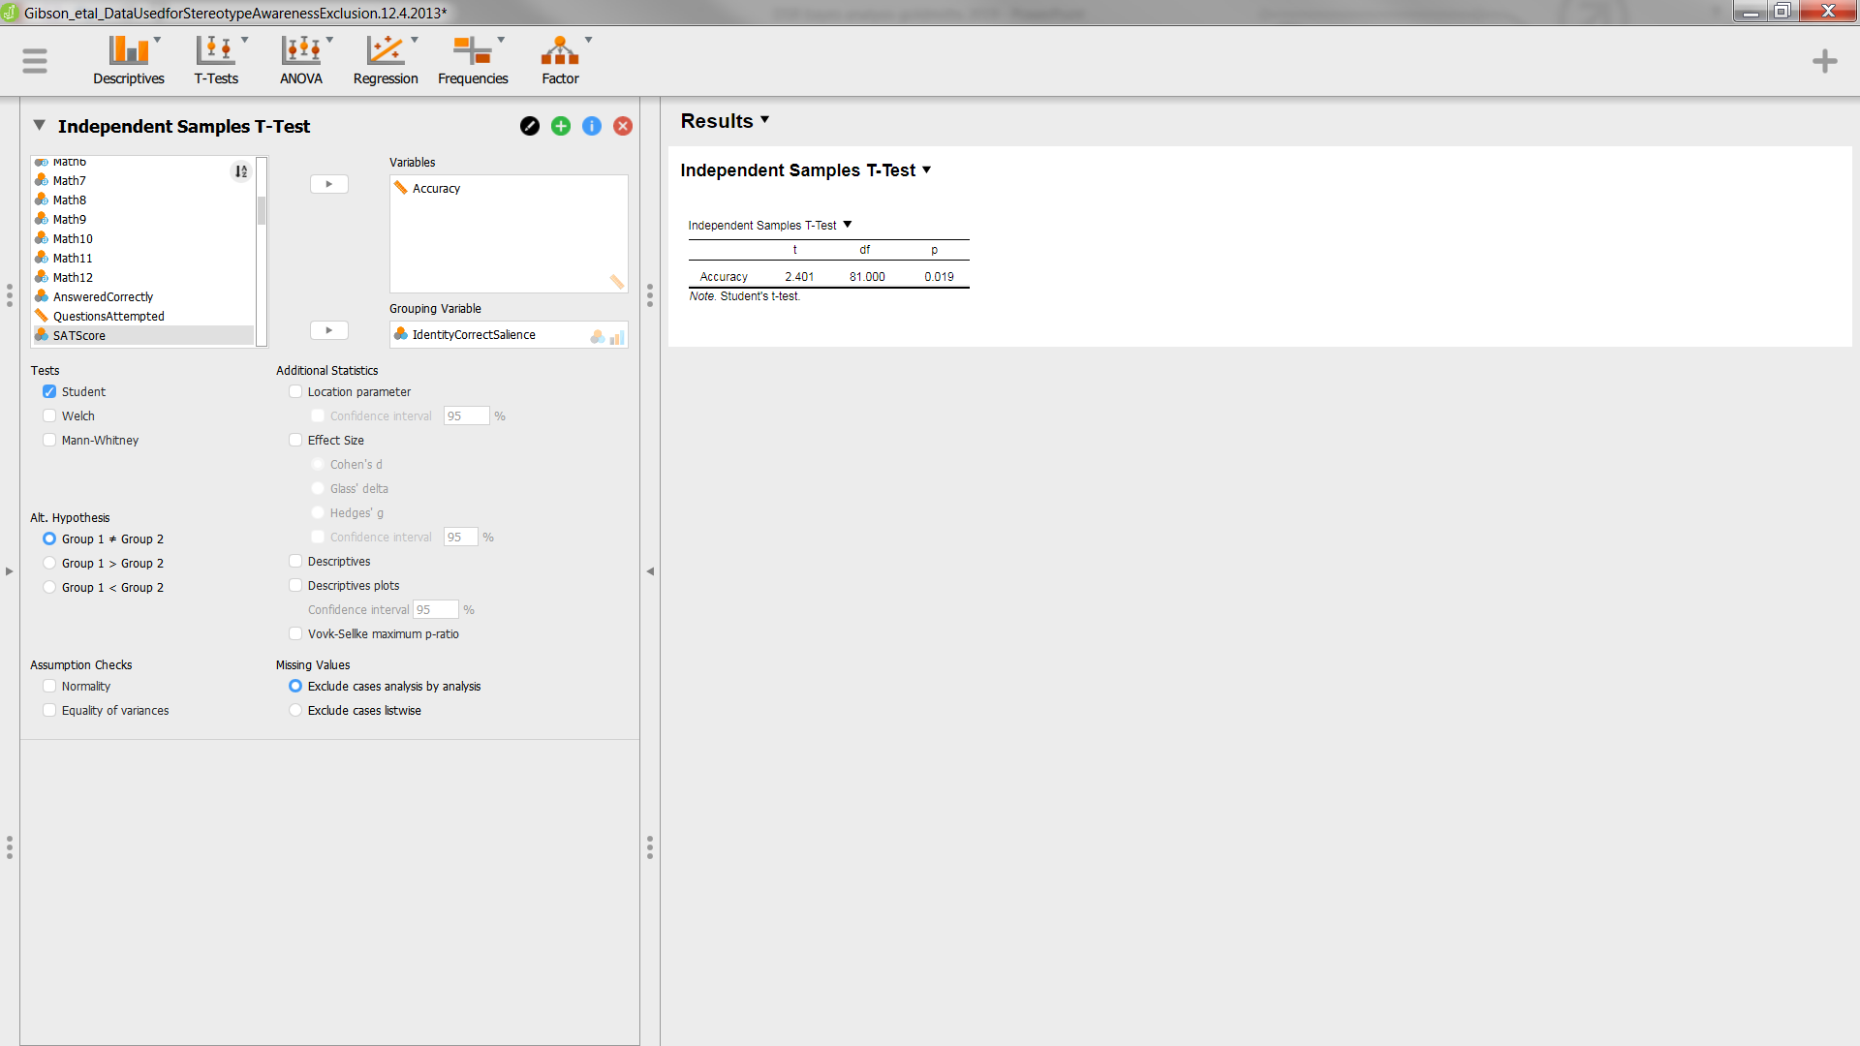
Indep gps t-test: Select variables

Slide 45
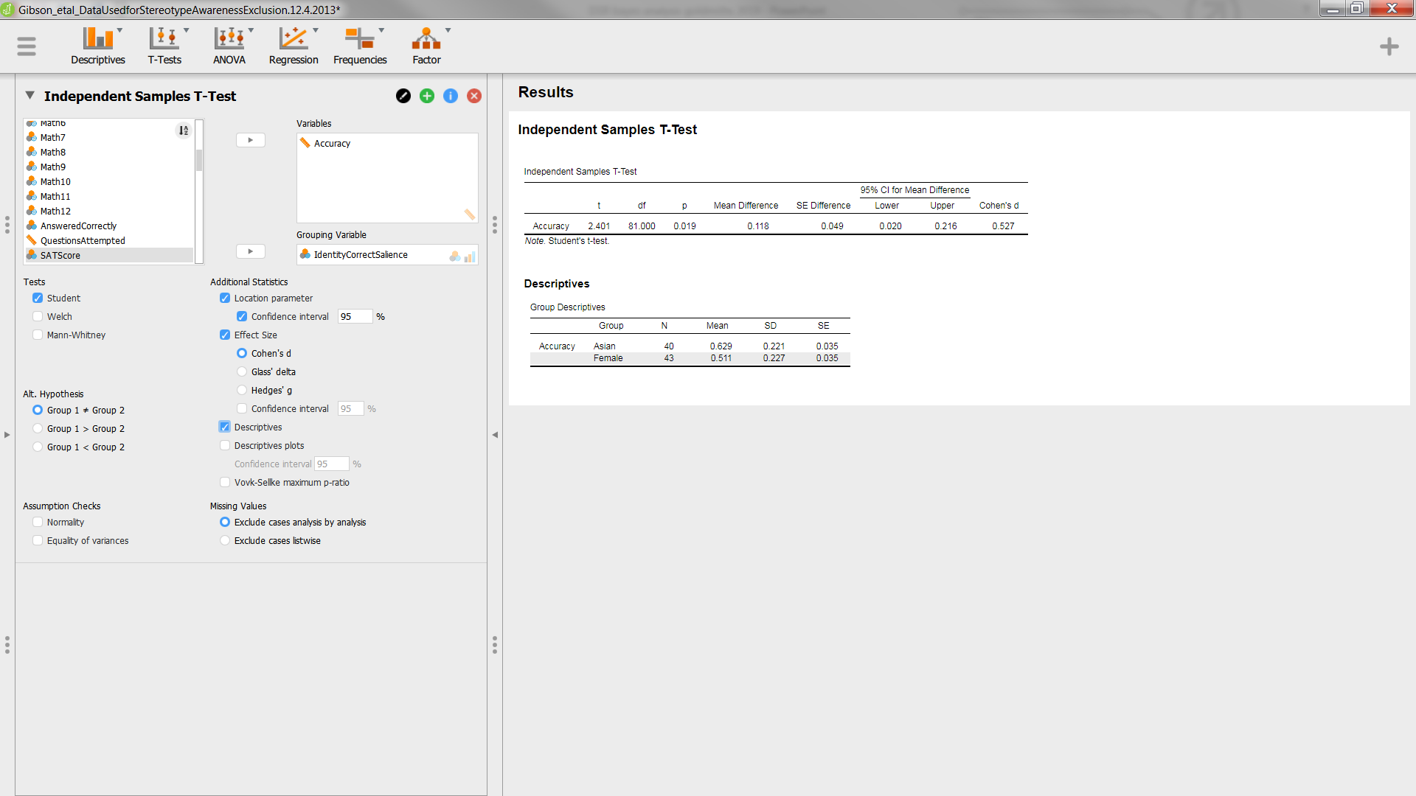
Indep gps t-test: Choose options

Slide 46
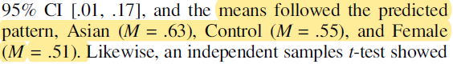
Indep gps t-test: Was it correct?
Group Descriptives
 |  | Group |  | N |  | Mean |  | SD |  | SE
Accuracy |  | Asian |  | 40 |  | 0.629 |  | 0.221 |  | 0.035
 |  | Female |  | 43 |  | 0.511 |  | 0.227 |  | 0.035
Gibson et al (2014)

Slide 47
Indep gps t-test: Was it correct?
Independent Samples T-Test
 |  |  |  |  |  |  |  |  |  |  |  | 95% CI for Mean Difference
 |  | t |  | df |  | p |  | Mean Difference |  | SE Difference |  | Lower |  | Upper |  | Cohen's d
Accuracy |  | 2.401 |  | 81.000 |  | 0.019 |  | 0.118 |  | 0.049 |  | 0.020 |  | 0.216 |  | 0.527
Note. Student's t-test.
Gibson et al (2014)

Slide 48

Now JASP’s Bayesian t-test

Slide 49
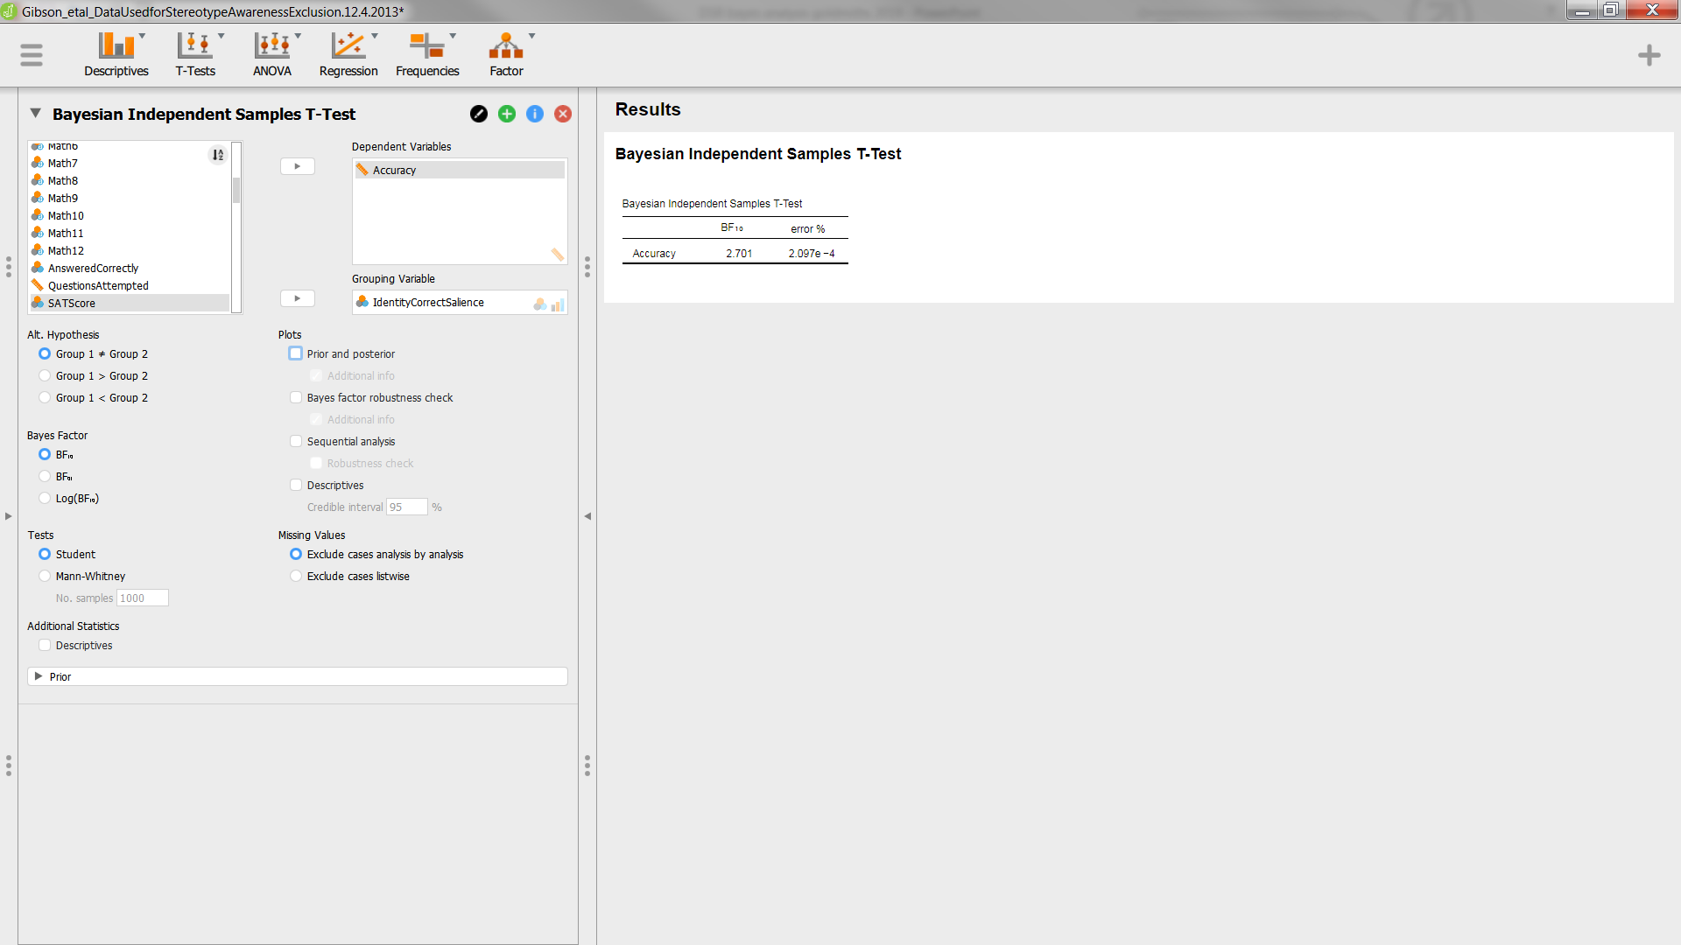
Bayesian t-test: Select variables

Slide 50
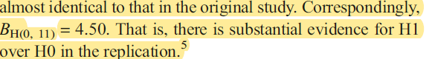
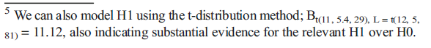
Bayesian t-test: Simple result
Bayesian Independent Samples T-Test
 |  | BF₁₀ |  | error %
Accuracy |  | 2.701 |  | 2.097e -4
Dienes & Mclatchie (2018)

Slide 51
Bayesian t-test: Why the difference?
It is the result of the priors used
The default in JASP is an uniformed prior, with a
mean =0
We can see this by setting some options

Slide 52
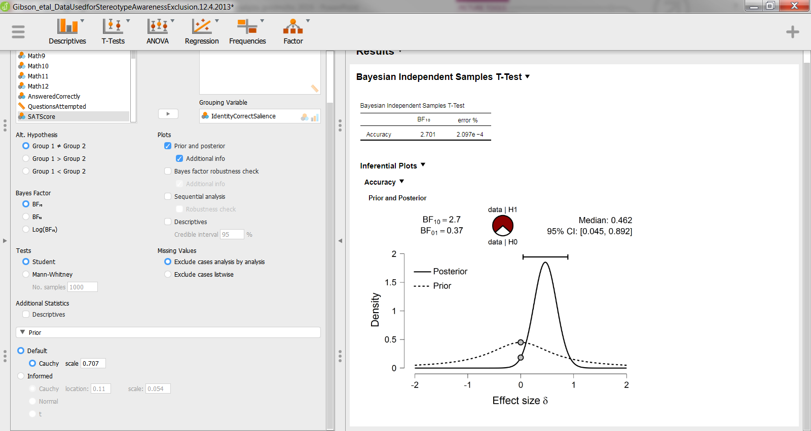
Bayesian t-test: Select options for priors

Slide 53
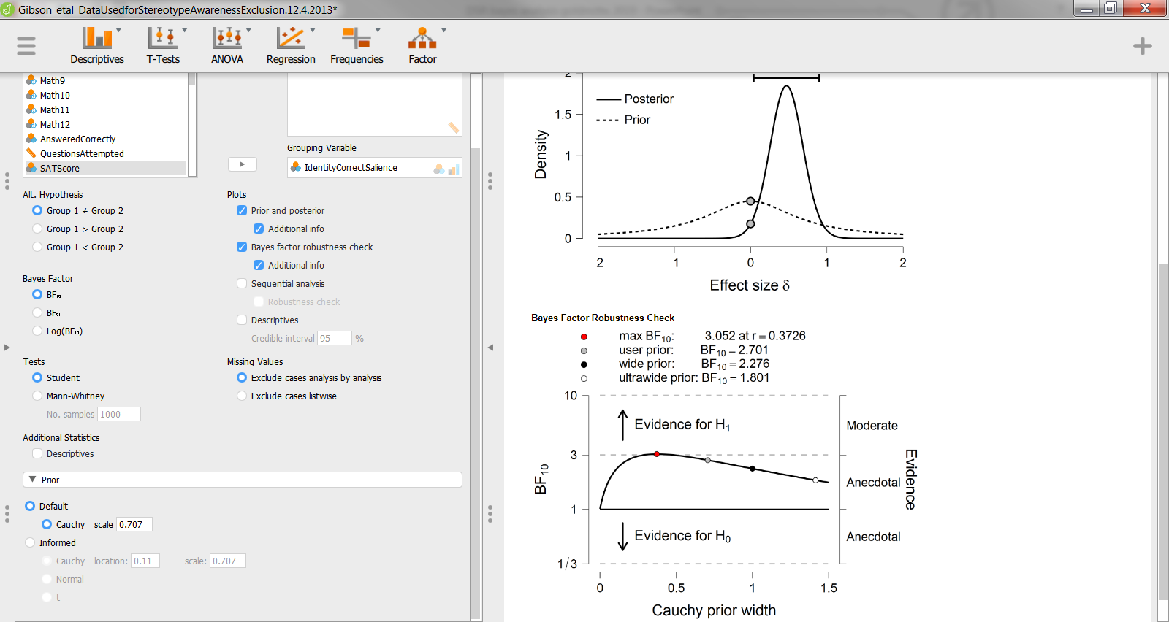
Bayesian t-test: Select options for priors

Slide 54
Bayesian t-test: The Dienes method
He has a website with lots of information and code (in Matlab, R etc)
http://www.lifesci.sussex.ac.uk/home/Zoltan_Dienes/inference/Bayes.htm
From there you can find a Javascript Bayes factor calculator:
https://medstats.github.io/bayesfactor.html

Slide 55
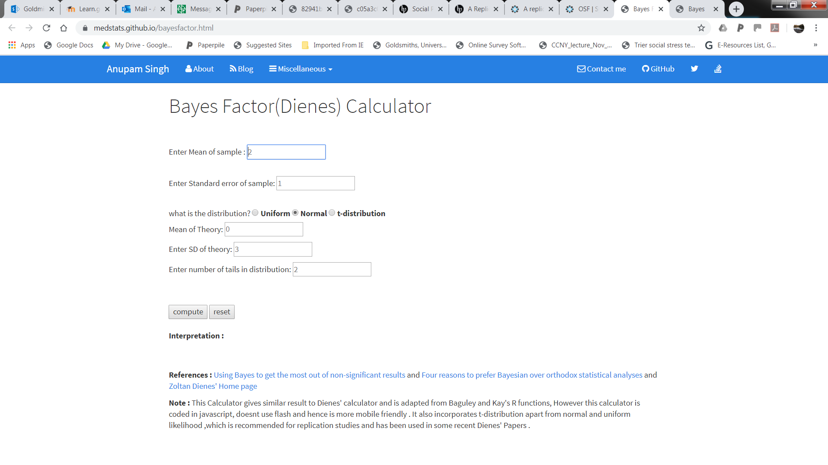
Bayesian t-test: Dienes calculator (half normal method)

Slide 56
Bayesian t-test: Dienes calculator
Works in raw units
Mean of sample = mean diff between 2 groups = 0.12
SE of sample = SE of diff between group means, and it can be derived from t value
t = diff between group means / SE of mean diff
SE of mean diff = group mean diff / t
From Gibson et al, t = 2.4
Therefore, SE mean diff = 0.12 / 2.4 = 0.05

Slide 57
Bayesian t-test: Dienes calculator
Use original 1999 study to provide “theory” distributions
Information is helpfully summairsed in Appendix of Dienes & Mclatchie (2018)

Slide 58
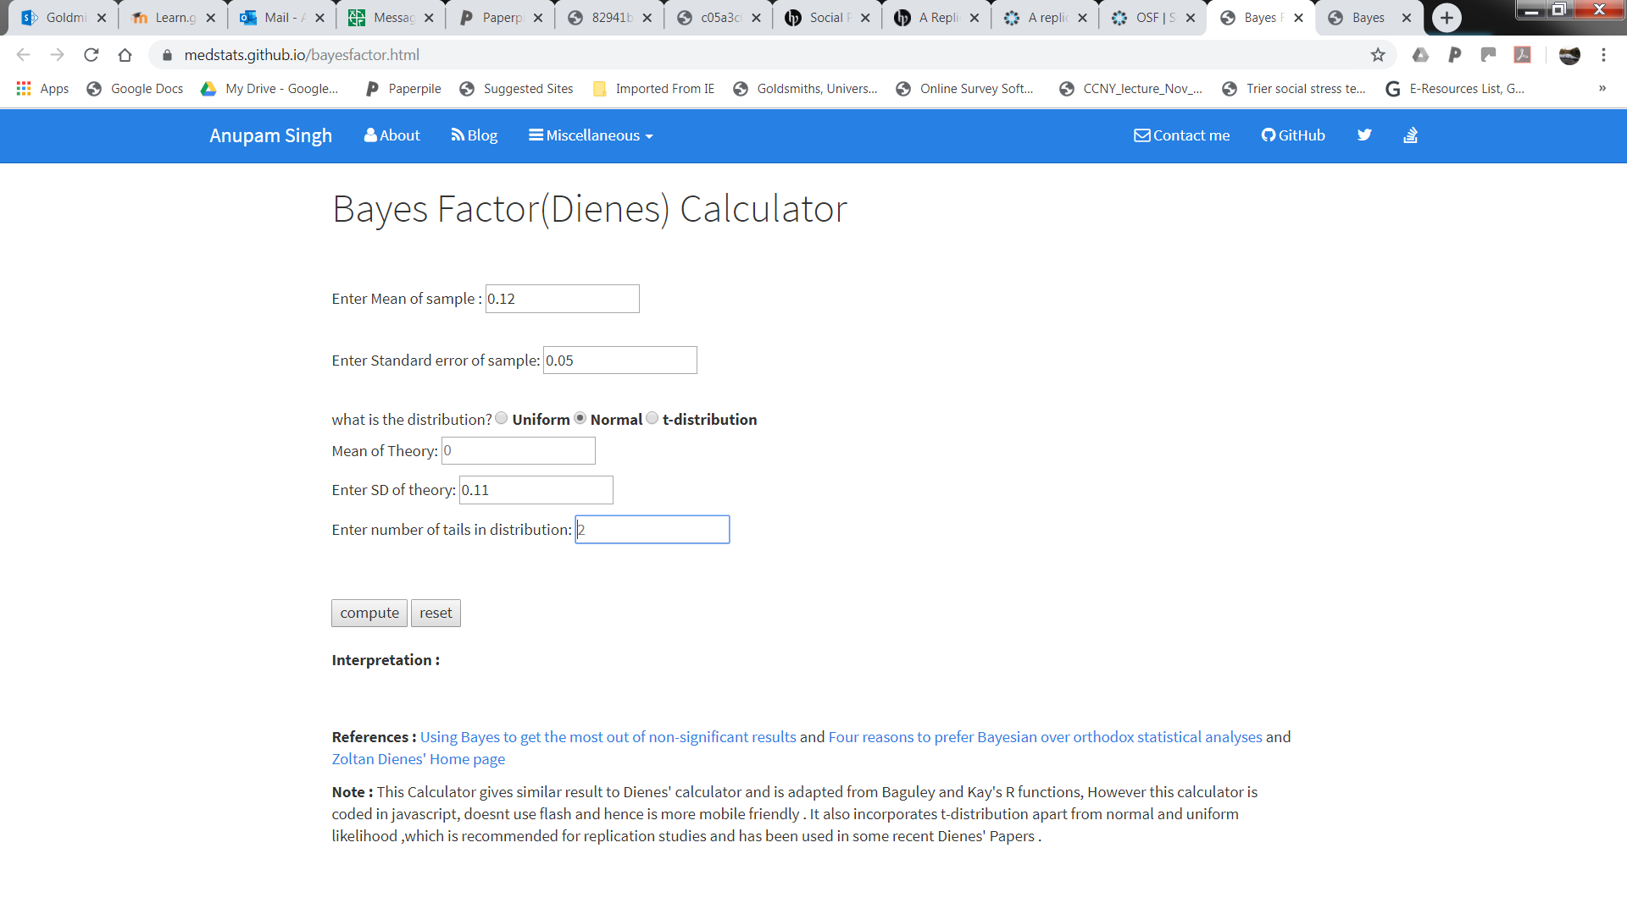
Bayesian t-test: Dienes calculator (half normal method)

Slide 59
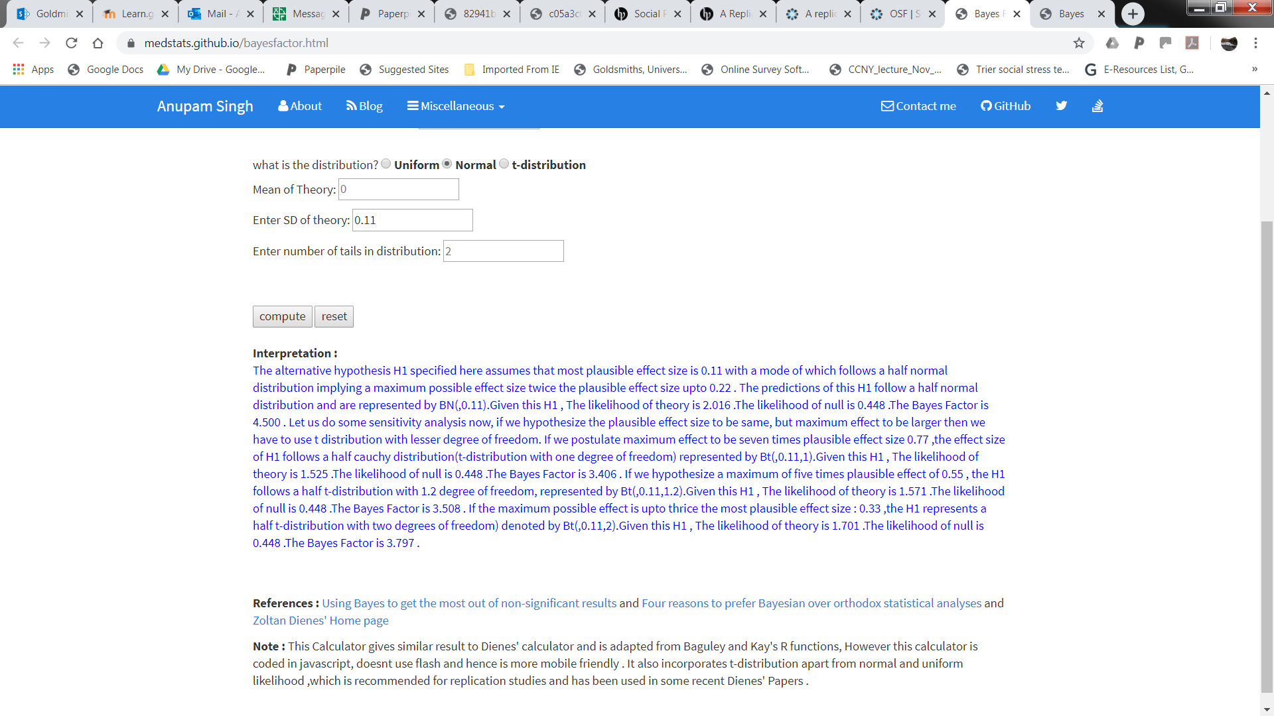
Bayesian t-test: Dienes calculator (half normal method)

Slide 60
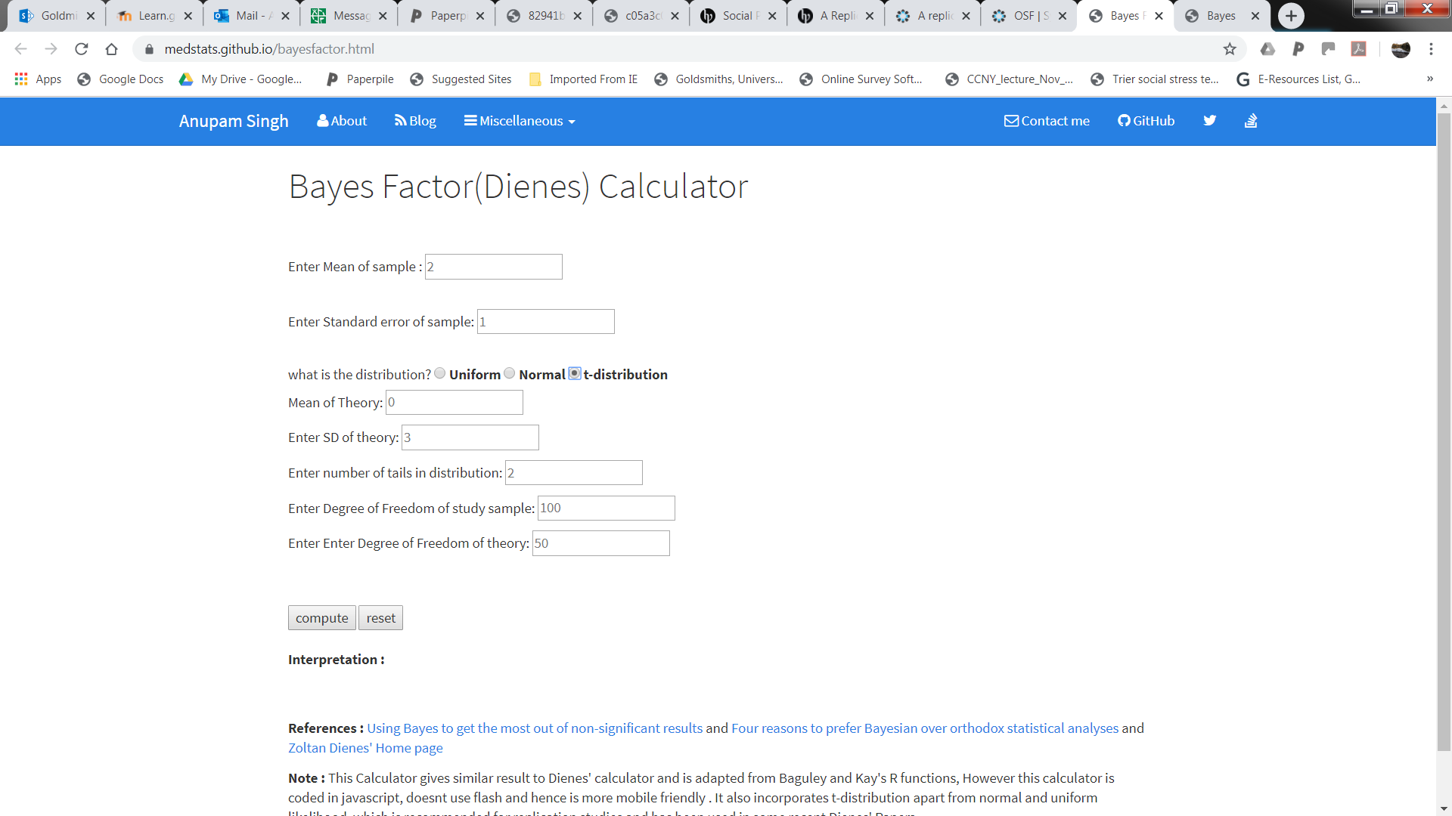
Bayesian t-test: Dienes calculator (t-distribution method)

Slide 61
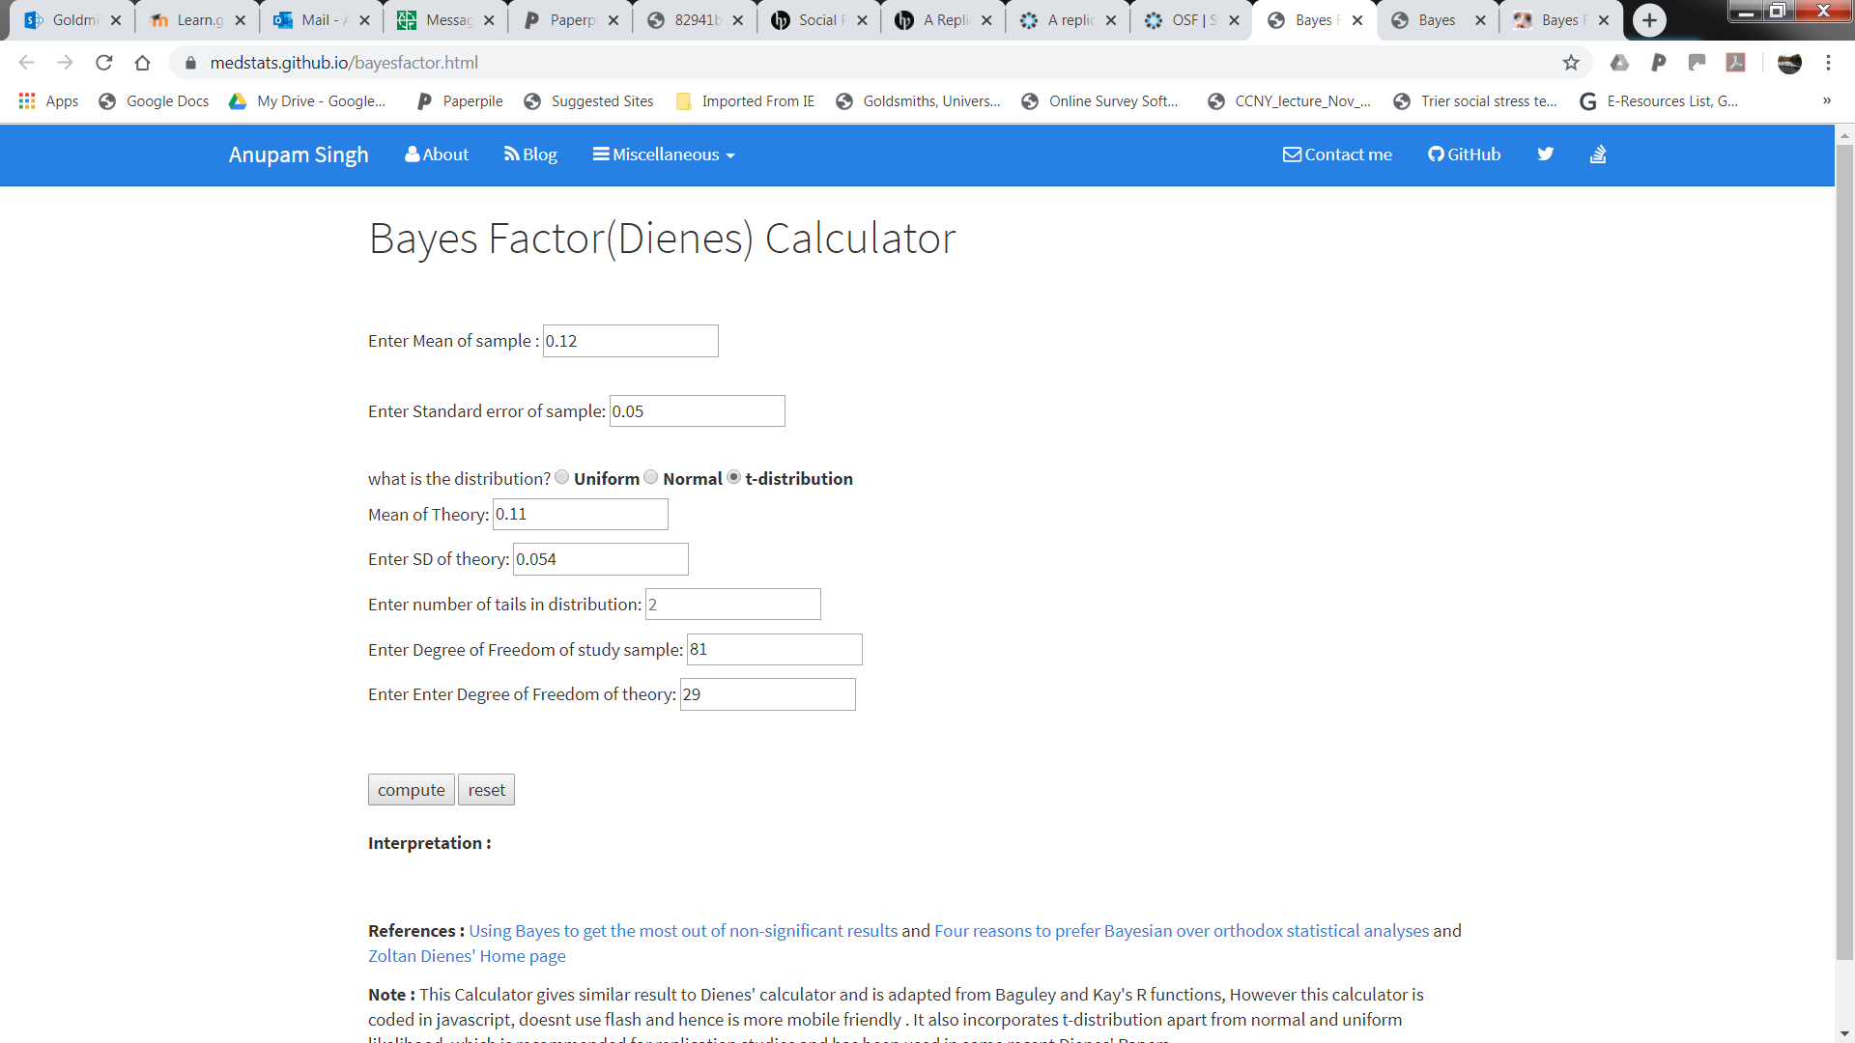
Bayesian t-test: Dienes calculator (t-distribution method)

Slide 62
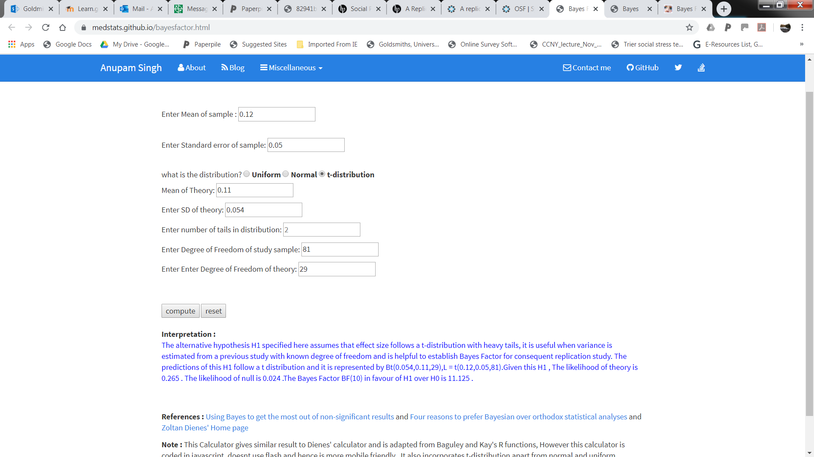
Bayesian t-test: Dienes calculator (t-distribution method)

Slide 63
Now you try to analyse another case study
Try the Johnson et al (2014; Study 2) replication of Schnall et al (2008)
You can find this paper in Social Psychology (2014, vol 45, issue 3)
https://us.hogrefe.com/products/journals/social-psychology
Perform a Bayesian t-test in JASP and using the Dienes online calculators
https://medstats.github.io/bayesfactor.html

Slide 64
Now you try to analyse another case study
You have to reduce 132 Ss to 126 selected subjects
Convert the variable Participant# to a nominal variable and deselect #s 10,42,56,88,118,150
The DV = wallet
The group variable is called Condition but you need to convert it to a nominal variable type first
Check results against Dienes & Mclatchie (p 214)
https://paperpile.com/shared/98BicZ/download/a8609525-f77d-0178-b31c-507c6ad0bcad

Slide 65
Thanks for listening

